Slide 1
Line Detection using Hough Transform
A Computer Vision Approach
-Kavimani V

Slide 2
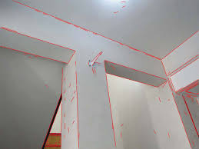
Line Detection is a critical task in computer vision used in various applications like object tracking, lane detection in autonomous vehicles, and document scanning
Hough Transform is a technique for detecting geometric shapes, such as lines, circles, and more, in an image.
Today, we will focus on Hough Transform for line detection.

Slide 3
Hough Transform
Given points:Edge points(xi,yi)
Transformations
Task : Detect line y=mx+c
Point Line
Line Point
Consider point(xi,yi)
Image space Parameter space
(xi,yi)
yi = mxi + c
c = -mxi + yi

Slide 4
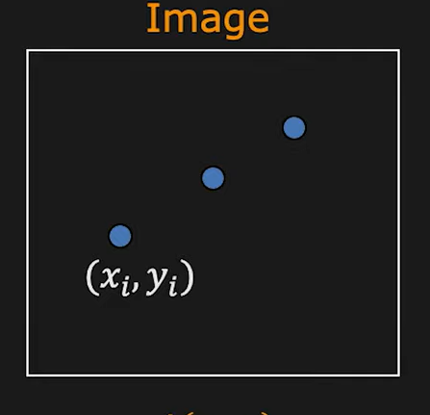
Line detection Algorithm
A(m,c)
Step 1: Quantize parameter space(m,c)
0 | 0 | 0 | 0 | 0
0 | 0 | 0 | 0 | 0
0 | 0 | 0 | 0 | 0
0 | 0 | 0 | 0 | 0
0 | 0 | 0 | 0 | 0
Step 2: Create Accumulator array A(m,c)
Step 3: Set A(m,c)=0 for all (m,c)
Step 4:For each edge point (xi,yi),
A(m,c)= A(m,c)+1
if (m,c) lies on the line : c=-mxi+yi
1 | 0 | 0 | 0 | 0
0 | 1 | 0 | 0 | 0
0 | 0 | 1 | 0 | 0
0 | 0 | 0 | 1 | 0
0 | 0 | 0 | 0 | 1
1 | 0 | 0 | 0 | 1
0 | 1 | 0 | 1 | 0
0 | 0 | 2 | 0 | 0
0 | 1 | 0 | 1 | 0
1 | 0 | 0 | 0 | 1
1 | 0 | 0 | 0 | 1
0 | 1 | 0 | 1 | 0
1 | 1 | 3 | 1 | 1
0 | 1 | 0 | 1 | 0
1 | 0 | 0 | 0 | 1
Step 5: Find the local maxima in A(m,c)

Slide 5
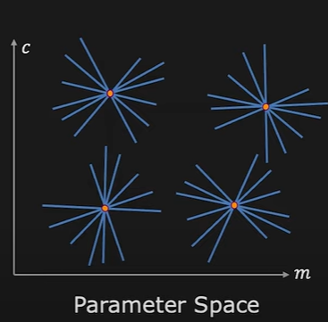
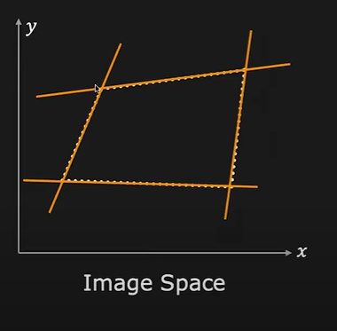
Multiple line detection

Slide 6


Better parameterization
m ranges from –infinity to +infinity
So we can use xsin – ycos + p=0
$$θ$$
$θ$
Since 0 < $θ$<
$$π$$
x
p
$$θ$$
y

Slide 7
